Slide 1
Identification of a Quench Location in a Superconducting RF Cavity
Ramesh Adhikari

Slide 2
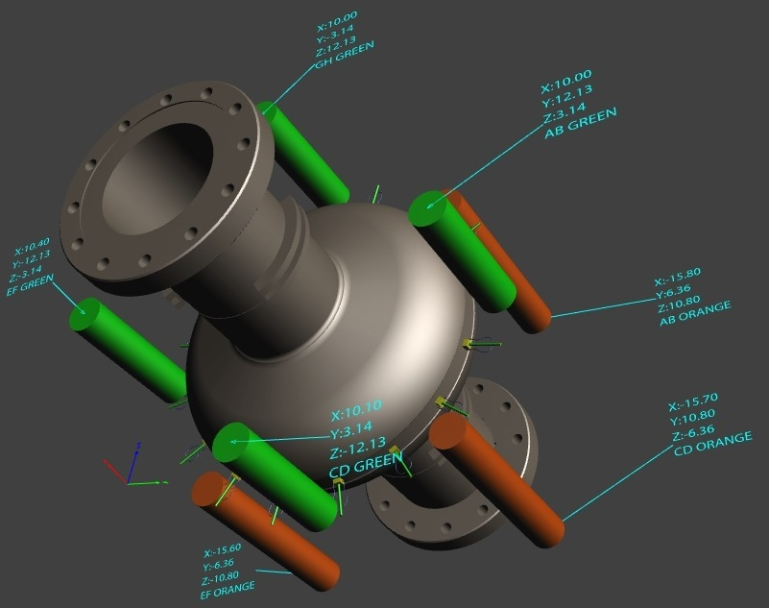
How to locate the quench?

Slide 3
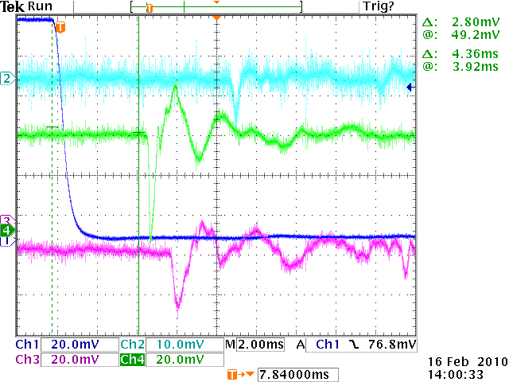
Data

Slide 4
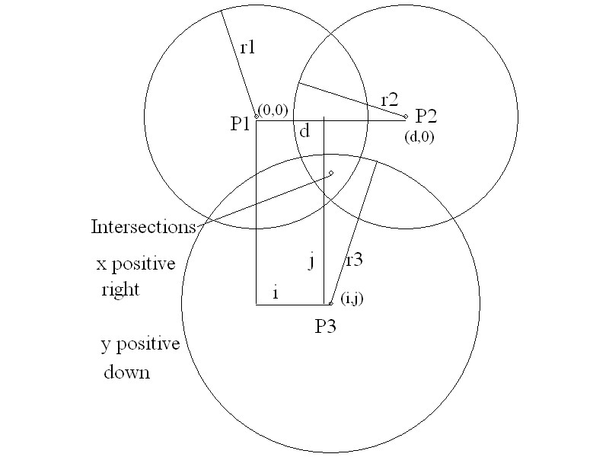
Trilateration

